Slide 1
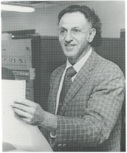
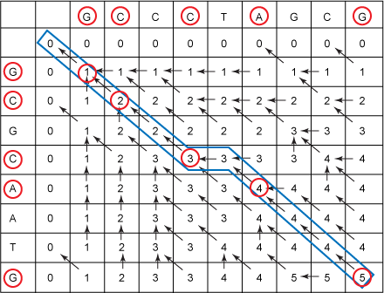
Dynamic Programming

Slide 2
Algorithmic Paradigms
Greed. Build up a solution incrementally, myopically optimizing some local criterion.
Divide-and-conquer. Break up a problem into two sub-problems, solve each sub-problem independently, and combine solution to sub-problems to form solution to original problem. Top-Down Recursion
Dynamic programming. Break up a problem into a series of overlapping, reusable sub-problems, and build up solutions to larger and larger sub-problems.
Bottom-up Recursion

Slide 3
Dynamic Programming History
Richard Bellman. Pioneered the systematic study of dynamic programming in the 1950s.
Etymology.
  Dynamic programming = planning over time.
  Secretary of Defense was hostile to mathematical research.
  Bellman sought an impressive name to avoid confrontation.
    "it's impossible to use dynamic in a pejorative sense"
    "something not even a Congressman could object to”
  Bellman’s Principle of Optimality: An optimal policy has the property that whatever the initial state and initial decision are, the remaining decisions must constitute an optimal policy with regard to the state resulting from the first decision. Such a problem is said to have “optimal substructure”.
  Bellman Equation: describes a necessary condition for optimality.
Reference: Bellman, R. E. Eye of the Hurricane, An Autobiography.

Slide 4
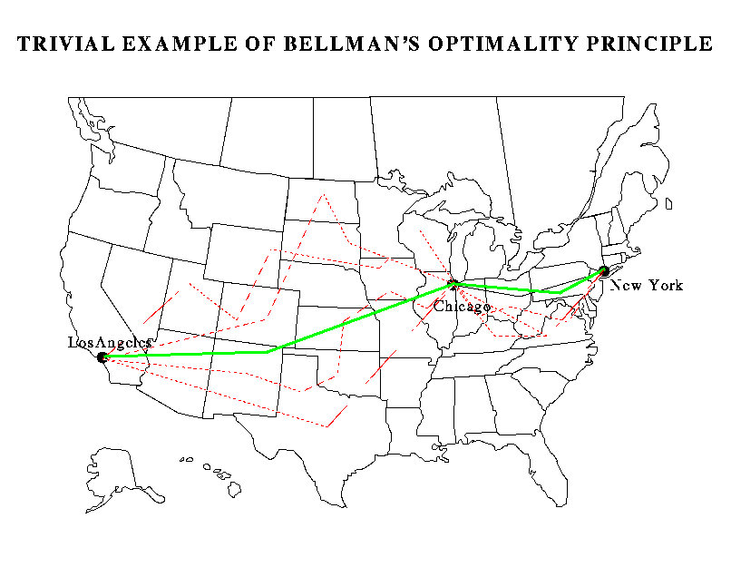

Slide 5
Dynamic Programming Applications
Areas.
  Bioinformatics.
  Control theory.
  Information theory.
  Operations research.
  Computer science: theory, graphics, AI, systems, ….
Some famous dynamic programming algorithms.
  Viterbi for hidden Markov models.
  Unix diff for comparing two files.
  Smith-Waterman for sequence alignment.
  Bellman-Ford for shortest path routing in networks.
  CKY algorithm for parsing context free grammars (CS670).

Slide 6
Problems we will consider using Dynamic Programming
Optimal Binary Search Trees
Shortest-Path Problem in Weighted Digraphs
    Bellman-Ford Algorithm
    Floyd’s Algorithm (all-pairs shortest paths)
Edit Distance

Slide 7
Dynamic programming is a design strategy that involves constructing a solution S to a given problem by building it up dynamically from solutions to smaller (or simpler) problems S₁, S₂, . . . , S_{m} of the same type. The solution to any given smaller problem S_{i} is itself built up from the solutions to even smaller (simpler) subproblems, and so forth. We start with the known solutions to the smallest (simplest) problem instances and build from there in a bottom-up fashion. To be able to reconstruct S from S₁, S₂, . . . , S_{m}, some additional information is usually required. We let Combine denote the function that combines S₁, S₂, . . . , S_{m}, using the additional information to obtain S, so that
S = Combine(S₁, S₂, . . . , S_{m})

Slide 8
Principle of Optimality
Formulation in text: Principle of Optimality holds if the following is always true: If S = Combine(S₁, S₂, . . . , S_{m}) and S is an optimal solution to the problem, then S₁, S₂, . . . , S_{m}, are optimal solutions to their associated subproblems.

Slide 9
Shortest Paths Satisfies Principle of Optimality
Proof by Contradiction
Assume the Principle of Optimality does not hold for shortest paths in weighted digraphs, i.e., there is a shortest P from x to y in a digraph D that contains vertex z, but the paths Q and R from x to z and z to y respectively are not both shortest paths. Assume without loss of generality that Q is not shortest, i.e., there exists a shortest path Q’ from x to z. Then replace Q with Q’ in P. This will result in a walk P’ from x to z that is shorter than P. Removing cycle from P’ will result in a path P’’ that is no greater in length than P’ since there are no negative cycles. This is a contradiction, since P’’ is shorter than P’ which in turn is shorter than P.

Slide 10
Floyd’s Algorithm for All-Pairs Shortest Paths
Floyd’s algorithms applies to a weighted digraph D, where will allow negative weights but no negative cycles.
A negative cycle is a directed cycle, i.e., closed path, such that the sum of the weights are negative.
Floyd’s algorithms solves the problem of finding shortest paths between all pairs of vertices in the digraph D.

Slide 11
Floyd’s algorithm continues
For k a nonnegative integer k ≤ n – 1, let V_{k} denote the subset of vertices {0,...,k} (by convention, V₋₁ = infinity). Let S_{k}(i,j) denote the weight of a shortest path P from i to j, whose interior vertices (if any) all lie in V_{k} (if no such path P exists, then S_{k}(i,j) = infinity). Since, by definition, S₋₁(i,j) is the weight of a shortest path from i to j containing no interior vertices, S₋₁ is equal to the weight matrix W defined as follows: W(i,j) = w(e) if D contains an edge e from vertex i to vertex j, 0 if i = j, and infinity otherwise. Note also that
S_{n-1}(i,j) is the weight of a shortest path in G from i to j.

Slide 12
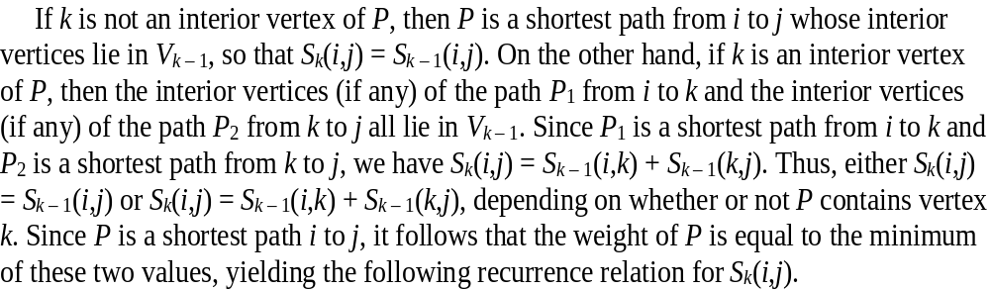

Deriving a recurrence relation for Floyd’s Algorithm using Principle of Optimality

Slide 13
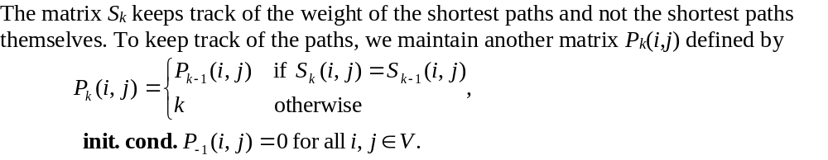
Keeping Track of Shortest Paths in Floyd’s Algorithm

Slide 14
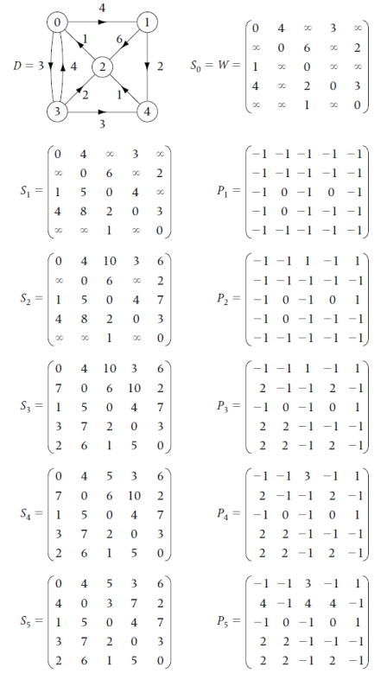
Stages of Floyd’s algorithm for a sample weighted digraph D where the index i is replaced by i +1

